Slide 1
Chapter 18
Sorting: A Deeper Look

Slide 2
Objectives
In this appendix, you’ll learn:
To sort an array using the selection sort algorithm.
To sort an array using the insertion sort algorithm.
To sort an array using the recursive merge sort algorithm.
To determine the efficiency of searching and sorting algorithms and express it in “Big O” notation.

Slide 3
18.1Introduction
Sorting places data in order
  Ascending or descending
This appendix introduces
  Selection sort algorithm
  Insertion sort algorithm
  Merge sort
Introduction of “Big O” notation
We will contrast ease of programming with efficiency of the algorithms
Exercises present additional sort algorithms

Slide 4
18.2 Big O Notation
O(1) means number of comparisons is constant
  Does not grow as the size of array increases.
An O(n) algorithm is referred to as having a linear run time.
  Grows linearly as the size of the array increases
Consider an algorithm that makes n²/2-n/2 comparisons
  As n increases, n² predominates
  O(n²) is quadratic run time

Slide 5
18.2 Big O Notation (Cont.)
When n is small, O(n²) algorithms will not noticeably affect performance
  As n grows, you’ll start to notice the performance degradation
O(n²) algorithms are easy to write
Efficient algorithms take a bit more cleverness and work to create,
  But their superior performance can be well worth the extra effort,

Slide 6
18.3 Selection Sort
Simple, but inefficient, sorting algorithm
First iteration of algorithm selects smallest element
  Swaps it with the first element
Second iteration selects smallest of remaining elements
  Swaps it with the second element
Continues until the last iteration selects second-largest element
  Swaps it with the second-to-last

Slide 7
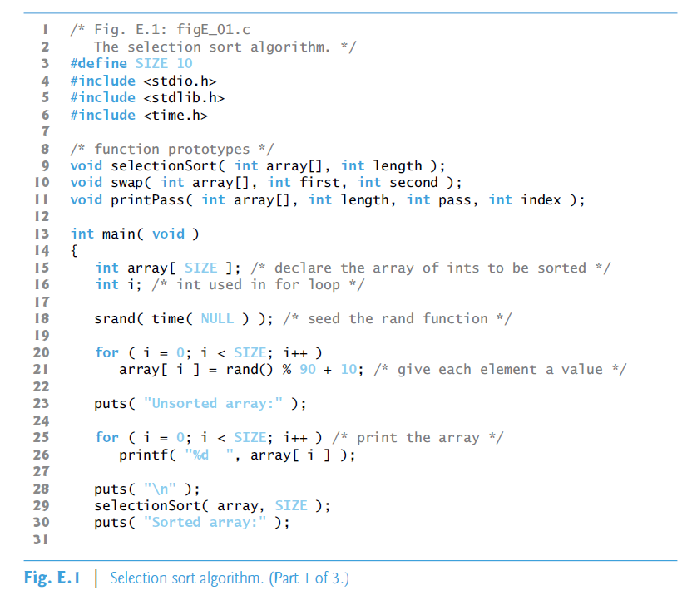

Slide 8
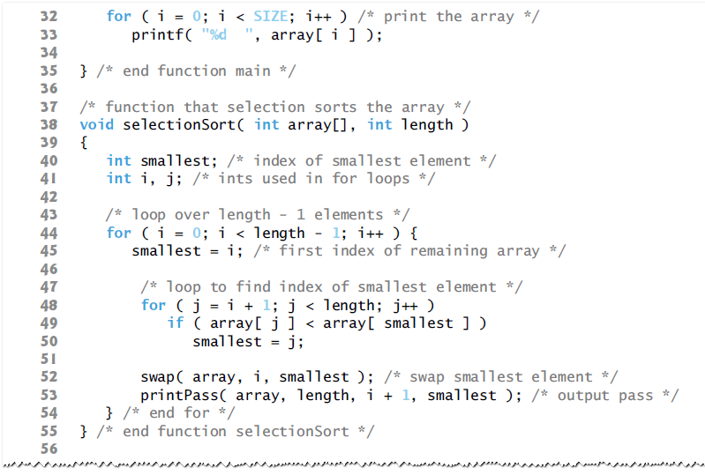

Slide 9
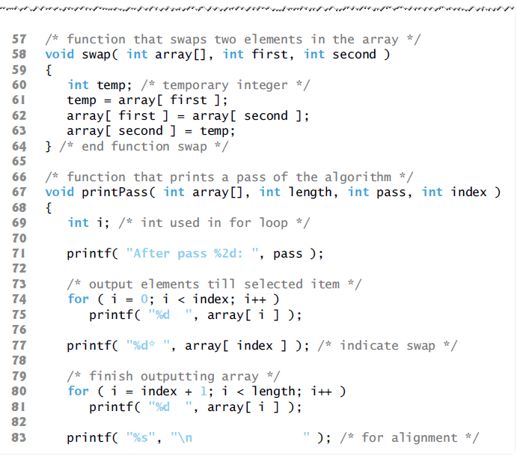

Slide 10
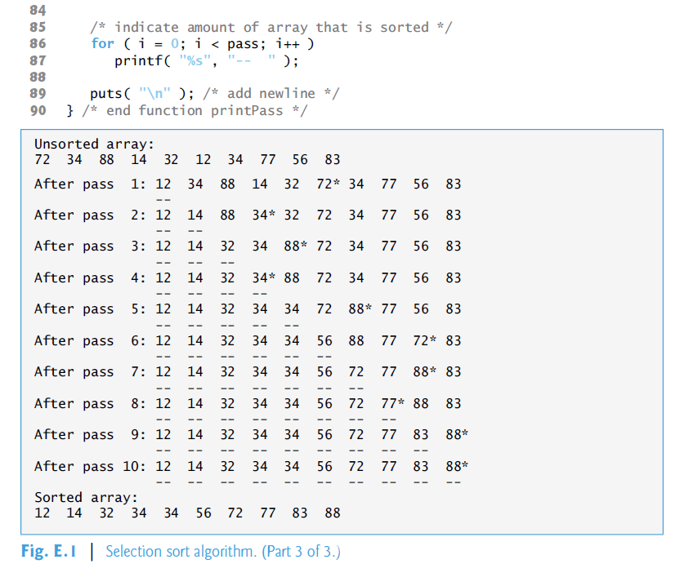

Slide 11
18.3 Efficiency of Selection Sort
Selection sort algorithm runs in O(n²) time
Contains two for loops
  Outer for loop (lines 45–55) iterates over the first
  n – 1 elements
  Inner loop iterates a total of n (n – 1) / 2 or
  (n² – n)/2 times
Big O notation
  Smaller terms drop out
  Constants are ignored
  Leaving a Big O of O (n²).

Slide 12
18.4 Insertion Sort
Another simple, but inefficient, sorting algorithm
First iteration views second element in array
  If it’s less than first element, swaps it with first element.
Second iteration looks at third element
  Inserts it into correct position with respect to first two elements
In the ith iteration of algorithm,
  First i elements in the original array will be sorted.

Slide 13
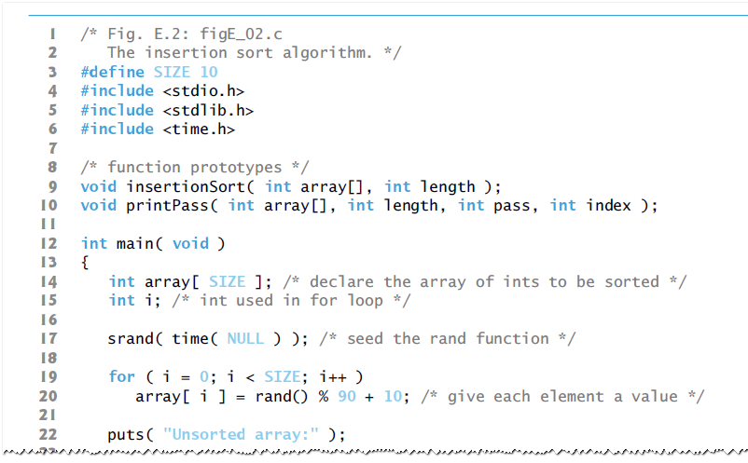

Slide 14
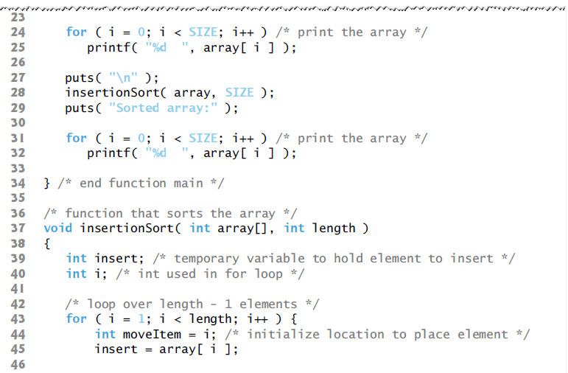

Slide 15
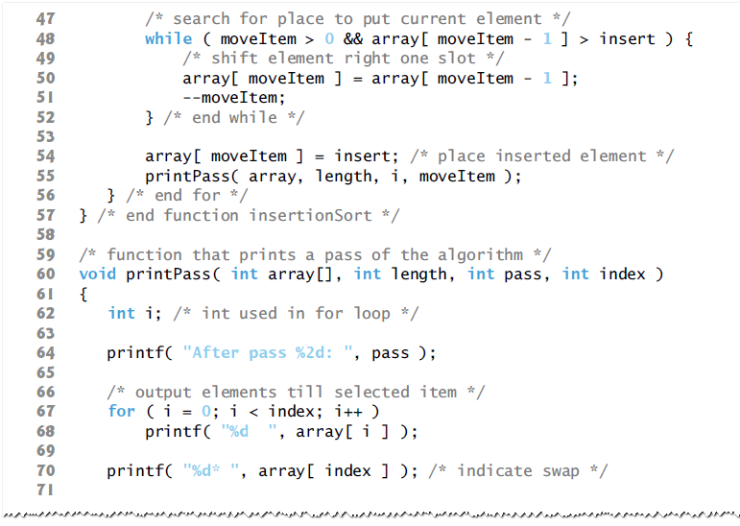

Slide 16
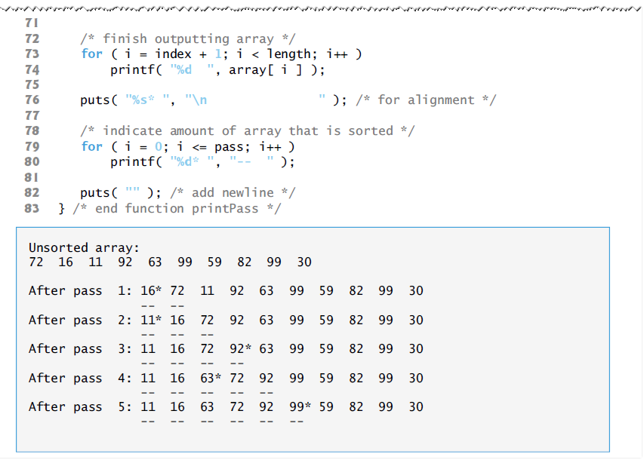

Slide 17
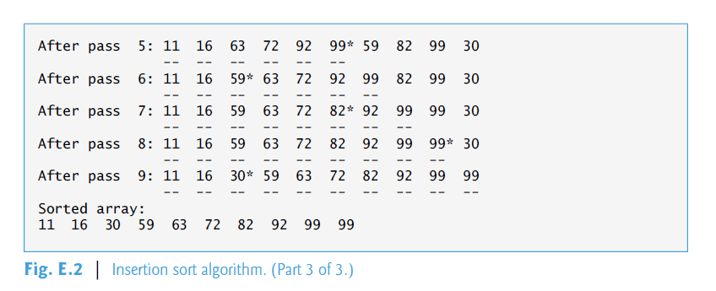

Slide 18
18.4 Efficiency of Insertion Sort
Also runs in O (n²) time
Uses two loops.
  for loop (lines 44–57) iterates SIZE - 1times
  In worst case, while loop requires n – 1 comparisons
Each individual loop runs in O (n) time.
  Nested loops – must multiply number of iterations of each loop.
Multiplying these values results in a Big O of O(n²).

Slide 19
18.5 Merge Sort
An efficient sorting algorithm,
  But is conceptually more complex
Sorts an array by splitting it into two equal-sized subarrays,
  Sorting each subarray,
  Then merging them into one larger array
Implementation of merge sort in this example is recursive

Slide 20
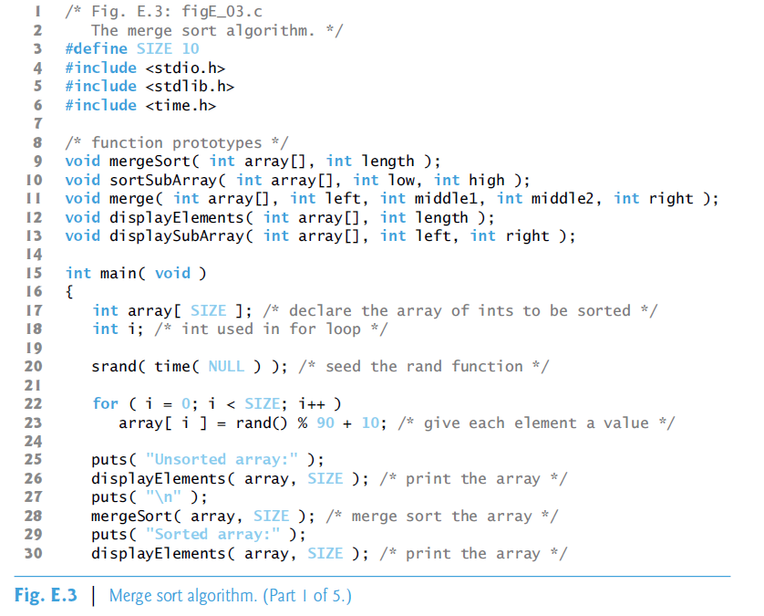

Slide 21
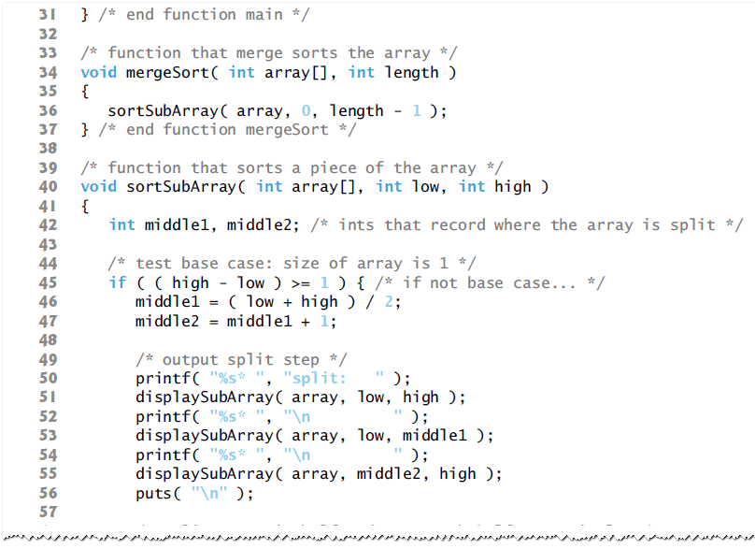

Slide 22
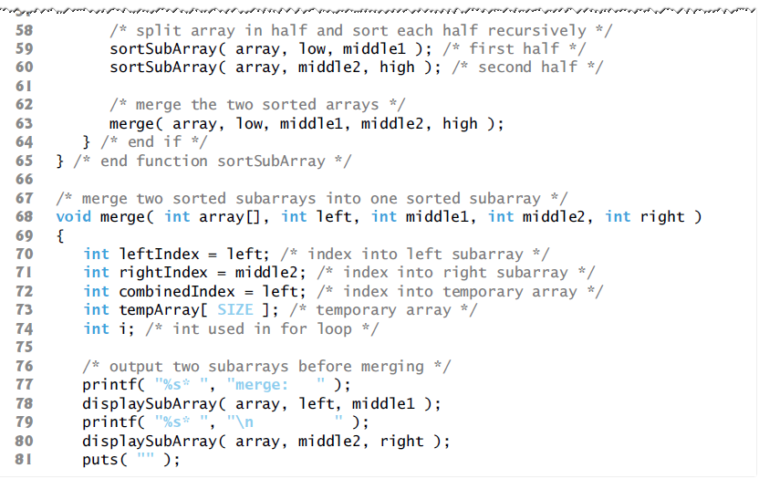

Slide 23
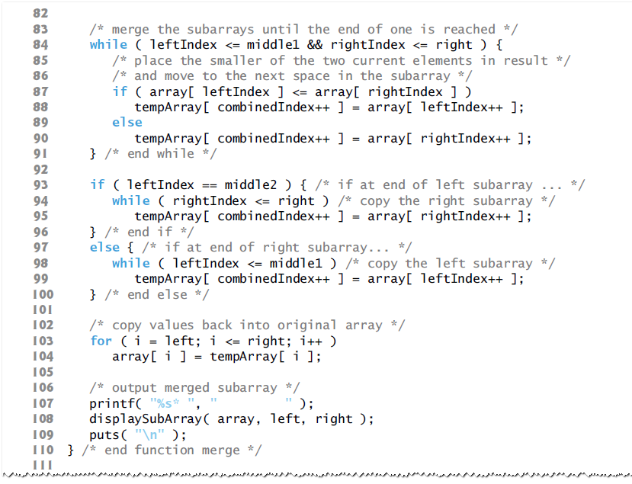

Slide 24
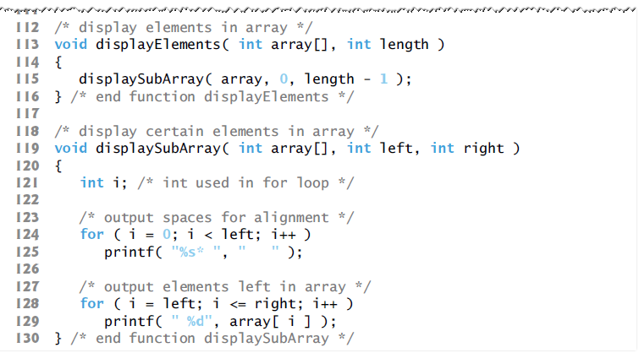

Slide 25
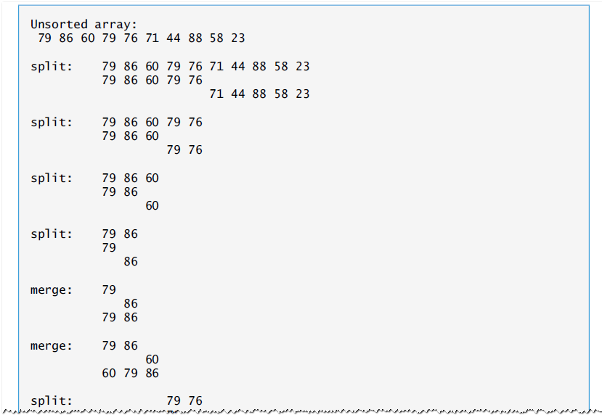

Slide 26
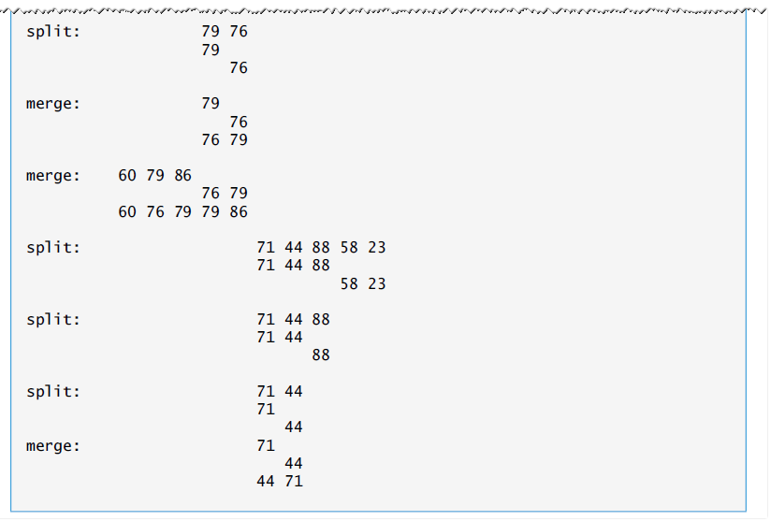

Slide 27
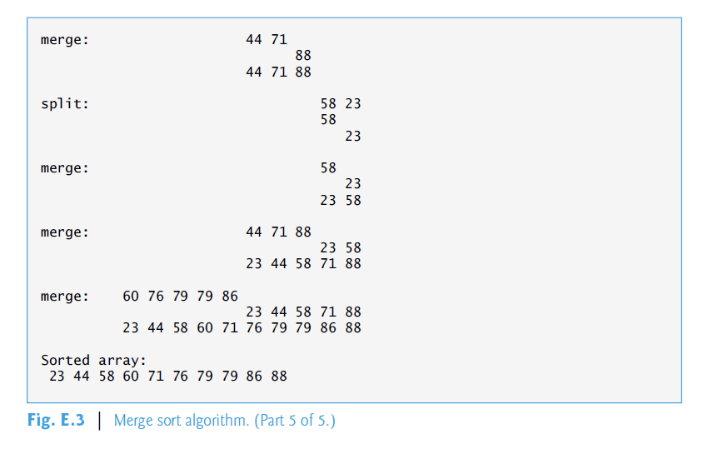

Slide 28
18.5 Efficiency of Merge Sort
Far more efficient algorithm than either insertion sort or selection sort
Call to function merge requires, at worst,
n – 1 comparisons
  Which is O(n).
Two calls to function merge each require, at worst, n/2 – 1 comparisons,
  For a total number of comparisons of O(n).
Each level splits size of the arrays in half,
  Doubling size of array requires one more level
Pattern is logarithmic
  Total efficiency of O(n log n).

Slide 29
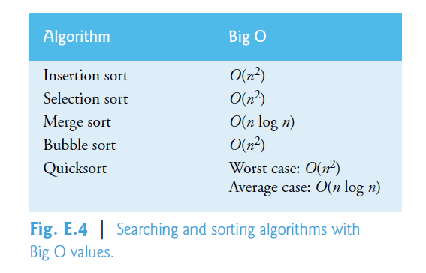
18.5 Efficiency of Merge Sort (Cont.)

Slide 30
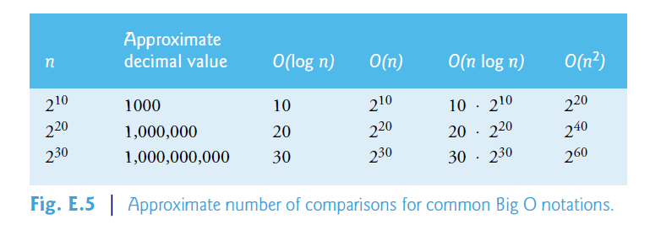
18.5 Efficiency of Merge Sort (Cont.)

